Slide 1
Notes:
Horizon Europe project Up2Circ intends to boost the uptake of circular business model, product and process innovation among European SMEs. So why is circular economy important?

Slide 2
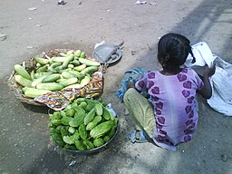
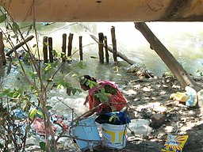
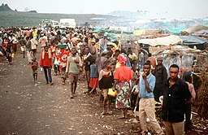
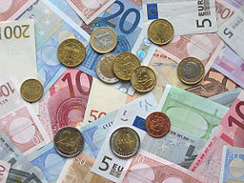
Relevance of Circular Economy
Social aspects
Manuspanicker, CC0, via Wikimedia Commons
Ecologic aspects
Apurv013, CC0, via Wikimedia Commons
Climate change
Consumption of virgin resources
World population
The world's current circularity
gap is over 90%
Necessary steps
CO2-neutrality
Decoupling growth from resource use
Photo courtesy of Peter Buschmann, United States Forest Service, USDA. Some additional editing by W.carter., Public domain, via Wikimedia Commons
United States government, Public domain, via Wikimedia Commons
Koalabaer2007, CC0, via Wikimedia Commons
Economic aspects
Avij (talk · contribs), Public domain, via Wikimedia Commons
Notes:
All the ecologic, social and economic challenges we face these days force us to rethink economy:
(Ecologic aspects) The impacts of climate change become more and more visible with floods, storms, droughts and woodfires all over the world - and let us recall that this is even much more severe in other parts of the world than in Europe! In addition the significant loss of biodiversity should remind us to preserve our livelihood and not to take the treasures this plant provides to us, like potable water, fertile soils and fresh air for granted!
(Social aspects) Our prosperity in Europe is based to a considerable extent on the poor working and living conditions of people in other parts of the world. Deep in the global supply-chains the products we buy often contain child labor or forced labor. Access to raw materials, which are in great demand, especially by industrialized countries, is one of the main causes of armed conflicts. All this leads to migration movements to Europe that we will not be able to stop, unless living conditions are improved. And even within Europe, social inequality increases which can threaten our democracies. Without more social justice, conflicts will further increase.
(Economic aspects) Europe has been committed to growth for decades, but at the moment the mountain of debt is growing and resources are getting scarce. Can we secure our economic foundations? How can we decouple growth from resource consumption? And what are we leaving behind for future generations? Sustainability is also indispensable from an economic point of view!
We have never been so many people on earth as today and per capita we have never consumed so many resources. According to Circularity Gap report only 7,2% of materials are cycled back into the global economy after the end of their useful life and this figure has constantly decreased throughout last years. But resources of the plant are limited and in addition producing new materials results in carbon emissions.
The concept of circular economy enables us to decouple growth from resource use, in addition the Circularity Gap Report estimates that a circular economy could reduce global GHG emissions by 39%. Therefore EU politics agreed on a Circular Economy Action Plan for Europe:

Slide 3
The New Circular Economy Action Plan
“the EU needs to accelerate the transition towards a regenerative growth model that gives back to the planet more than it takes, advance towards keeping its resource consumption within planetary boundaries, and therefore strive to reduce its consumption footprint and double its circular material use rate in the coming decade”

Slide 4
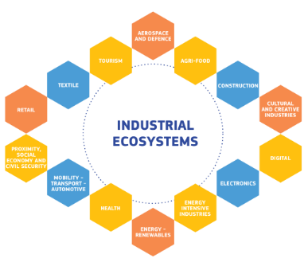
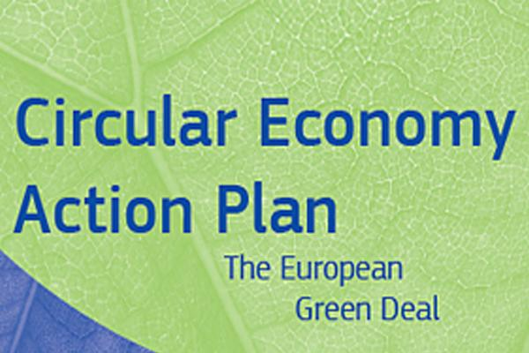
Transforming the EU‘s economy for a sustainable future
Make the transition to modern, resource-efficient and competitive economy, ensuring:
no net emissions of greenhouse gases by 2050, 55% reduction by 2030
economic growth decoupled from resource use
no person and no place left behind
A New Industrial Strategy: Each of the 14 EU industrial ecosystems needs to transform its business models and value chains to form the basis for a green, digital and resilient European economy. Transition pathways are being developed.
Detailed plan of legislative and non-legislative EU measures that targets how products are designed, promotes circular economy processes, encourages sustainable consumption, and aims to ensure that waste is prevented and the resources used are kept in the EU economy for as long as possible.
Notes:
Let‘s have a quick look into the political framework
European Green Deal
New Industrial Strategy
Circular Economy Action Plan
(Usually this short slide should be sufficient, but if you want to go more in depths, the following slides 5-8 give more details)

Slide 5
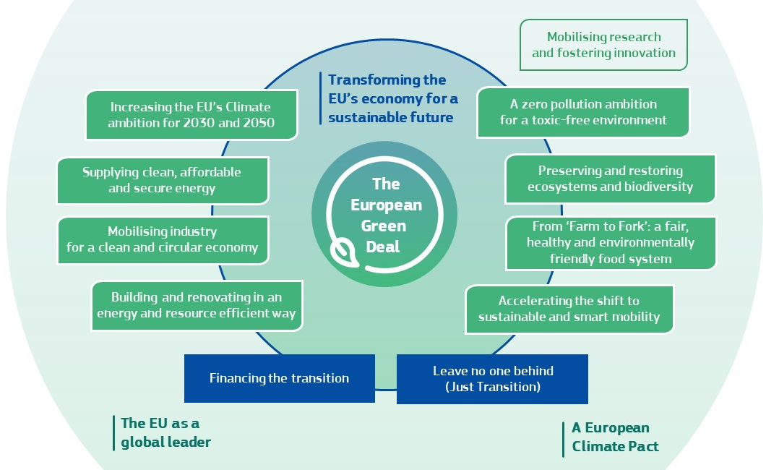
Political Framework: The EU Green Deal
Make the transition to modern, resource-efficient and competitive economy, ensuring:
no net emissions of greenhouse gases by 2050, 55% reduction by 2030
economic growth decoupled from resource use
no person and no place left behind

Slide 6
A New Industrial Strategy
Pathways how to transition EU industries towards a competitive, green and digital Europe.
Each of the 14 EU industrial ecosystems needs to transform its business models and value chains to form the basis for a green, digital and resilient European economy.
Transition pathways are being developed to better understand the scope, costs and long-term benefits of the desired measures in each of them.

Slide 7
CEAP initiatives along the entire product life cycle
improving durability, reusability, upgradability and reparability, addressing the presence of hazardous chemicals, increasing energy and resource efficiency
increasing recycled content in products
enabling remanufacturing and high-quality recycling
reducing carbon and environmental footprints
restricting single-use and premature obsolescence
introducing a ban on destruction of unsold durable goods
incentivising product-as-a-service
mobilising potential of digitalisation of product information
rewarding products based on sustainability performance
review of the Industrial Emissions Directive, including the integration of circular economy practices in upcoming Best Available Techniques reference documents
facilitating industrial symbiosis by developing an industry-led reporting and certification system, and enabling the implementation of industrial symbiosis
supporting the sustainable and circular bio-based sector through the implementation of the Bioeconomy Action Plan
promoting the use of digital technologies for tracking, tracing and mapping of resources
promoting the uptake of green technologies through a system of solid verification by registering the EU Environmental Technology Verification scheme as an EU certification mark.
production processes
sustainable consumption
product design
consumers shall receive relevant information on products at the point of sale, including on their lifespan and on the availability of repair services, spare parts and repair manuals
strengthening consumer protection against green washing and premature obsolescence, setting minimum requirements for sustainability labels/logos and for information tools
establishing a new ‘right to repair’
minimum mandatory green public procurement (GPP) criteria

Slide 8
Specific actions targeting key value chains:
Electronics and ICT
design for energy efficiency, durability, reparability, upgradability, maintenance, reuse and recycling
right to repair
Compatibility of chargers
EU-wide take back scheme
Restriction of hazardous substances
Textiles
Ecodesign measures, access to re-use and repair services
incentives and support to product-as-service models, circular materials and production processes
boosting the separate collection of textile waste, sorting, re-use and recycling of textiles
Batteries and vehicles
rules on recycled content, collection and recovery of valuable materials
phasing out of non-rechargeable batteries
transparency requirements
Construction and buildings
A new comprehensive Strategy for a Sustainable Built Environment to ensure coherence across the relevant policy areas such as climate, energy and resource efficiency, management of construction and demolition waste, accessibility, digitalisation and skills.
Packaging
reduce, reuse, recycle
reduce complexity of packaging materials
Food, water and nutrients
food waste reduction
substitution of single-use items in food services
circular approaches on water reuse and efficiency in agriculture, gardening and industrial processes
wastewater treatment and sewage sludge
Plastics
avoiding microplastics pollution
introducing bio-based, biodegradable or compostable plastics
Notes:
Electrical and electronic equipment: One of the fastest growing waste streams in EU, currently less then 40% recycled: Value is lost when fully or partially functional products are discarded because they are not reparable, the battery cannot be replaced, the software is no longer supported, or materials incorporated in devices are not recovered. Design for energy efficiency and durability, reparability, upgradability, maintenance, reuse and recycling
Batteries and vehicles: This is much about battery recycling where few SMEs are involved, but could be interesting with regard to applying product-as-service solutions to reduce virgin material consumption, use sustainable alternative transport fuels, optimise infrastructure and vehicle use, increase occupancy rates and load factors, and eliminate waste and pollution.
Packaging: Reduce, reuse, recycle (reduce complexity of packaging materials)
Plastics: avoiding microplastics pollution, e.g. tyres, textiles, ship coatings; introducing bio-based, biodegradable or compostable plastics
Textiles: 60% of clothing in EU is produced outside, but textile sector in EU is recovering and is mostly composed of SMEs. High use of primary materials and water.
Construction and buildings: Requires vast amounts of resources and accounts for over 35% of the EUs total waste generation. Material extraction, manufacturing of construction products, construction, renovation. Plus we could add: Efficient use of buildings.
Food, water and nutrients: Food waste reduction, single-use items in food services, water reuse and efficiency in agriculture, gardening and industrial processes; wastewater treatment and sewage sludge;
In addition in SPI: furniture, steel, cement, chemicals
Priority sectors in the Sustainable Product Initiative: Energy related (appliances and electronic equipment), chemical products, construction (precast concrete, steel beams and columns, insulation, windows and doors), transport and automotive (tyres, oils and oil filters), textiles (shoes, garment and carpet), toys.

Slide 9
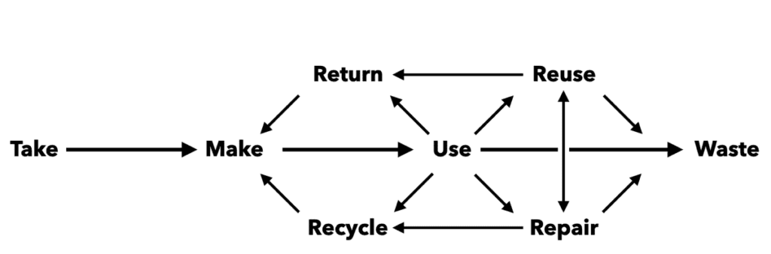
Introduction to Circular Economy
slow
narrow
close
Main principles of the circular economy:
Eliminate waste and pollution
Circulate products and materials at their highest value
Regenerate natural systems
regenerate
Did you know that up to 80% of products’ environmental impacts are determined at the design phase?
The circular economy offers a profitable opportunity to
move away from resource-intensive processes,
maximise the use of existing assets,
create new revenue streams and preserve natural capital
Notes:
So let us have a look at the main concepts of circular economy:
Our current linear economy takes resources, makes products out of them that consumers can use until they end up as waste. But there is no waste in nature, therefore we should consider the human-made concept of waste as a design flaw rather than as inevitable by-products of the things we make. Whereas the linear economy usually starts to think about disposal or recycling at end of life of a product, the circular economy aims to eliminate waste and pollution initially at design stage. A producer in the circular economy takes responsibility for the whole lifecycle of a product.
The key concept to decouple growth from use of finite resources is to keep products and materials in use as long as possible and to circulate them at their highest value. Products are designed to be reused, repaired, remanufactured and if this is not possible recycled.
Linear economy has destroyed the balance of our natural ecosystems. To ensure supply of fresh air, potable water and fertile soils we need not only to reduce emissions and contamination, but also to promote biodiversity and natural loops, e.g. by avoiding hazardous materials, returning biodegradable and compostable materials to the biological cycle making sustainable use of water.
In green you see the circular strategies that can be applied to the material and energy flows of any business:
Narrow (use less material and energy during design, production, delivery and use – e.g. lightweight production)
Slow (use products, components and material longer – e.g. easy to repair, upgradability)
Close (use wasted products, components and materials again – e.g. remanufacture and enable and incentivize product returns)
Regenerate (make clean by using non-toxic and biodegradable materials and renewable energy – e.g. non-toxid and biodegradable painting)
For companies transition towards circular business models, circular product design and circular processes can be a profitable opportunity. Many companies struggle with the raising material and energy costs. Applying circular strategies can be a chance for you to
move away from resource-intensive processes,
maximise the use of existing assets,
create new revenue streams and preserve natural capital

Slide 10
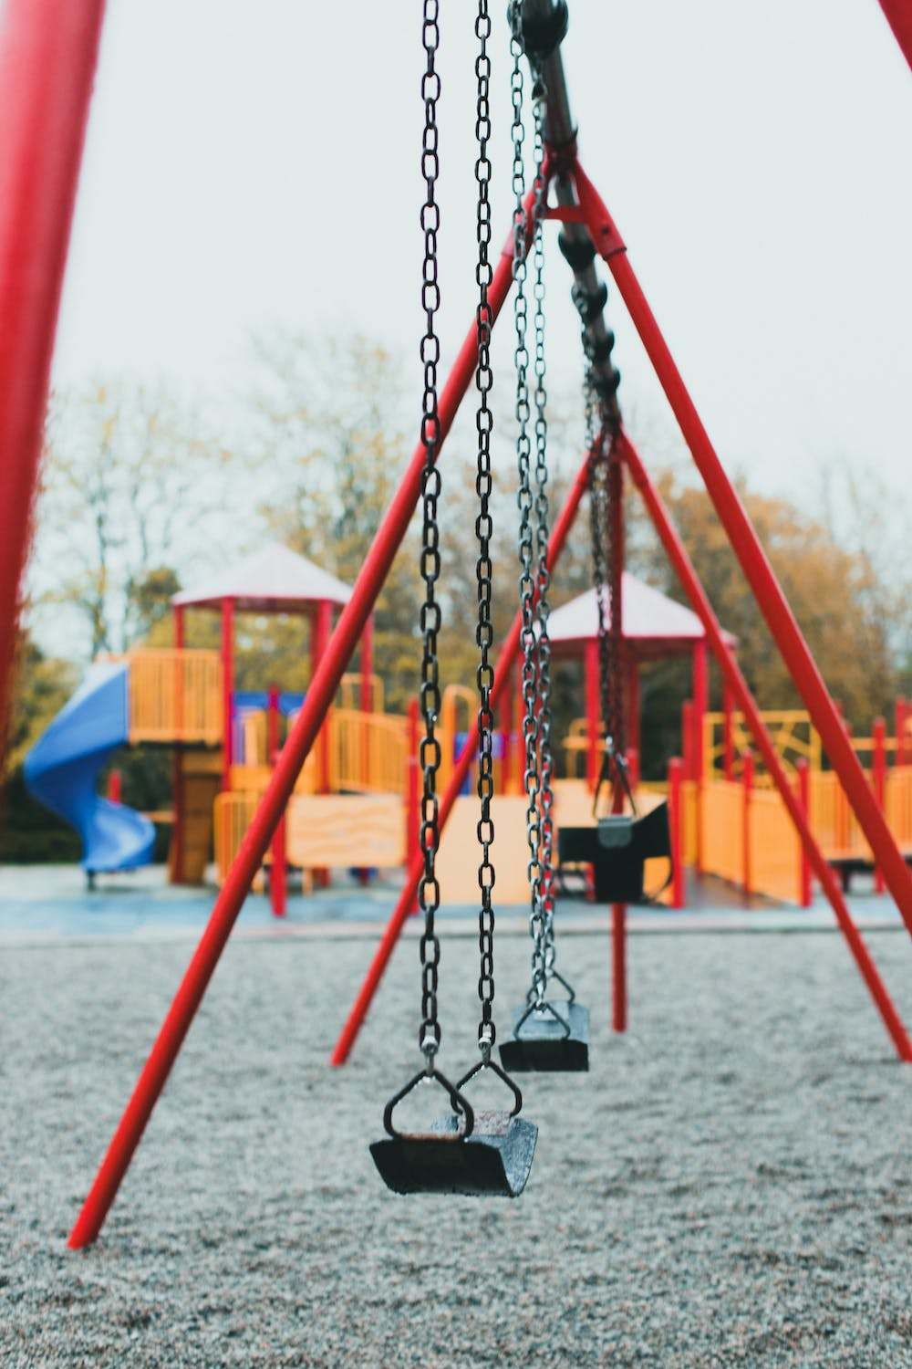
Understanding opportunities of the circular economy in contrast to the inefficiencies of linear economy
Example: Manufacturer of playground equipment
Use of materials
Product lifetime
Product capacity
End of life value
Kids grow fast, interests change…
Are durability and recyclability a criterium for material selection?
Are reparability, modularity and upgradeability considered?
Do your products realise their full potential?
How do you imagine the end of lifetime for your product?
Notes:
To understand the opportunities of the circular economy let us look at the inefficiencies of the linear economy – let’s look for example at a manufacturer of playground equipment, who build this swing.
Which inefficiencies can you detect?
Use of materials: Many products break down too quickly, cannot be easily reused, repaired or recycled, and many are made for single use only. The swing might be made of recyclable and durable materials but it is probably not designed for recyclability and no recycled materials have been used in production.
Product lifetime: This swing is built for long lifecycles and high durability, but kids grow quickly and interests change. Is it designed for enhanced reparability, modularity and upgradeability? The full potential of after-sales services is not exploited.
Product capacity: Many kids could have fun with this swing, but most playground equipment, especially in private gardens, is rather rotting then being fully utilized.
End of life value: Materials might allow for remanufacture or high quality recycling, but with sales the materials are gone and the producer is not connected to the user anymore.

Slide 11
Approaches for circular innovation
Product innovation
Process innovation
Business model innovation
Use of materials
Design the product for closed loop recycling
Substitution of virgin raw materials by bio-based or recycled materials
Build a circular supply chain
Product lifetime
Use modular design that may be adjusted when kids grow
Apply LEAN manufacturing processes with standardized parts
Develop a portfolio for product life extension
Product capacity
Swings as a service for a monthly fee
End-of-life value
Design products to be remanufactured
Apply ICT processes enabling reverse logistics and refund system
Offer a take-back scheme
Notes:
How can these inefficiencies be adressed with product, process and business model innovations based on CE strategies? Have in mind the circular industrial strategies to narrow, slow, close and regenerate!

Slide 12
How did other companies transform towards circular economy?
The Czech company BRENS Europe develops and manufactures products for the construction of railway tracks, level crossings and noise protection measures.
Challenge The company has long perceived that it cannot keep drawing on non-renewable resources. Instead, it decided to start using waste for production.
Solution
BRENS works with recyclates from concrete or tyres. It recycles and reuses waste materials: scrap iron, concrete and rubber rubble. BRENS experts have also taken advantage of the excellent technical and utility properties of the material from the automotive industry. This is why one of the latest projects, a tram track noise absorber, is made from reprocessed offcuts from car seats, carpets, filters and shredded rubber from used tyres.
Notes:
Let‘s look at how other companies took steps to transition towards circular economy!

Slide 13
How did other companies transform towards circular economy?
KODAS is a producer of high-quality natural fermented drinks and other products, located in Southern Estonia.
Challenge The main waste in the production process of juice and juice drinks is the pressing residue of apples or other fruits. Until recently, the pressing residues were useless bio-waste for the company, which had to be composted and the associated costs had to be covered.
Solution
Kodas has developed a technology for refining the press residue for human consumption. For example, recipes for fiber-rich apple and berry purees have been developed. This makes the entire production process more environmentally friendly and economically efficient. Besides the significant increase in resource efficiency, the residue-based products have helped to enrich the product range of Kodas.

Slide 14
How did other companies transform towards circular economy?
FRANCE CONSTRUCTION/HEXDALLE designs and produces damping materials to cover all the risks in playgrounds, gyms, shooting ranges or industry since 1997.
Challenge The main material France Construction uses is rubber. The company started reflecting on the impact of sustainability several years ago and decided to use recycled (and recyclable) rubber. In a next step the company intends to close the loop and move up the value chain by recovering, grinding and recycling rubber waste.
Solution
The company worked on a business plan to validate the technical and economic aspects to recover and recycle rubber waste in their own facilities. The objective is to avoid tyre disposal in landfill sites, strengthen own expertise on recovering and recycling of rubber waste as well as to secure the supply chain.

Slide 15
How did other companies transform towards circular economy?
siebold/hamburg provides all kinds of services in the field of design and construction of exhibition stands and shop fittings as well as the procurement and storage of related materials.
Challenge Exhibitions only take place for few days, but for a successful trade fair appearance the booths should catch the eye and every customer has special wishes and requirements. Nevertheless siebold/hamburg wanted to offer a climate-neutral trade fair presence.
Solution
siebold/hamburg applies the most economical use of materials and a high level of reuse. Using the software UMBERTO for Carbon Footprint, alternative material and storage lists can be evaluated with their reusability and recycling proportions and CO2 emissions of the booth can be calculated. Partnering with ForestFinance Group customers can offset the remaining CO2 emissions.

Slide 16
How did other companies transform towards circular economy?
FAGUM STOMIL is a Polish manufacturer of safety footwear that has been operating since 1899. It produces footwear made from polymers for industrial and household applications.
Challenge The company already used recycled materials but was still facing high production and energy costs and high environmental charges for disposal of production wastes.
Solution
Fagum Stomil introduced the world's first industrial recycling technology for used EVA footwear. Material from production waste, that was previously disposed of in a landfill or incineration plant, is recovered and customers are invited to return their end-of-life wellingtons. Thanks to the use of waste materials and to saving charges for disposal, the company could significantly reduce production costs.

Slide 17
How did other companies transform towards circular economy?
REYNALDI SRL SB is an Italian company with more than 40 years of experience in formulating and producing natural cosmetics.
Challenge The company wanted to develop innovative and functional cosmetic products made from natural and sustainable raw materials and reduce the environmental footprint of production.
Solution
Reynaldi invested in a filter system that recovers the water used in the production, purifies and re-introduces it in a closed cycle water usage. The plant paid off in 3 years, and now represents a minor cost. Reynaldi invested in a start up that produces innovative raw materials from food production waste. Introduction of circular raw materials has the potential to reduce CO2-footprint and makes the supply chain more resilient. A challenge were the regulatory barriers, as often by products derived from industrial sites are labelled as special waste which prohibits their usage.

Slide 18
How did other companies transform towards circular economy?
GRUPO NATAC S.L.U., headquartered in Spain, is dedicated to researching, developing, manufacturing and marketing natural ingredients to be used in food supplements, feed, pet food, as well as in functional foods and as natural, active pharmaceutical ingredients.
Challenge To sustainably manufacture natural plant extracts and ingredients, Natac valorizes biomass from agro-industry. Main challenges encountered were the great variability in the state of raw materials, regulatory aspects and the need to bring together very heterogeneous actors from very different sectors.
Solution
Natac built strategic alliances with the most important local producers, who now follow Natac’s criteria regarding the cultivation, harvesting, and processing of raw materials. This enhances the beneficial properties in the ingredients. Natac has been able to recycle 98% of the waste generated.

Slide 19
What is your Up2Circ vision?

Slide 20
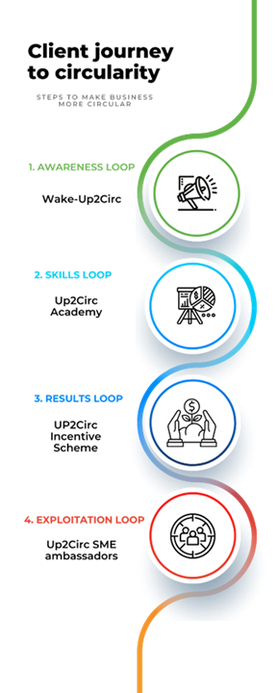
Your Up2Circ client journey
Explore opportunities to innovate towards circularity and discover benefits for your company!
Design a detailed action plan based on an in-depth assessment. Participate in a comprehensive set of learning modules for circular business model, product and process innovation!
Implement transition measures with support of EU-funding! Up2Circ Incentive Scheme supports the uptake of circular business models (<15.000€) and the uptake of circular product or process innovation (<50.000€)
Belong to a network of Up2Circ SME ambassadors and share your success story with other SMEs and stakeholders within the EU innovation support ecosytem
To apply for funding in Up2Circ Incentive Scheme, prior active involvement in Up2Circ Academy is required!
Notes:
With Up2Circ small and medium sized enterprises (SMEs) can
discover opportunities of circular innovation
learn how to develop a suitable action plan for transition measures
apply for funding of implementation projects
later share their experiences
To apply for funding in Up2Circ Incentive Scheme, prior active involvement in Up2Circ Academy is required!

Slide 21
This project targets SMEs!
Are you are a small or medium sized enterprise according to the EU definition?
< 250 staff headcount
≤ € 50 m turnover or
≤ € 43 m balance sheet total
To check if you are eligible as an SME please use the EU self assessment questionnaire
Notes:
Condition to participate is that you are an SME according to the EU definition.

Slide 22
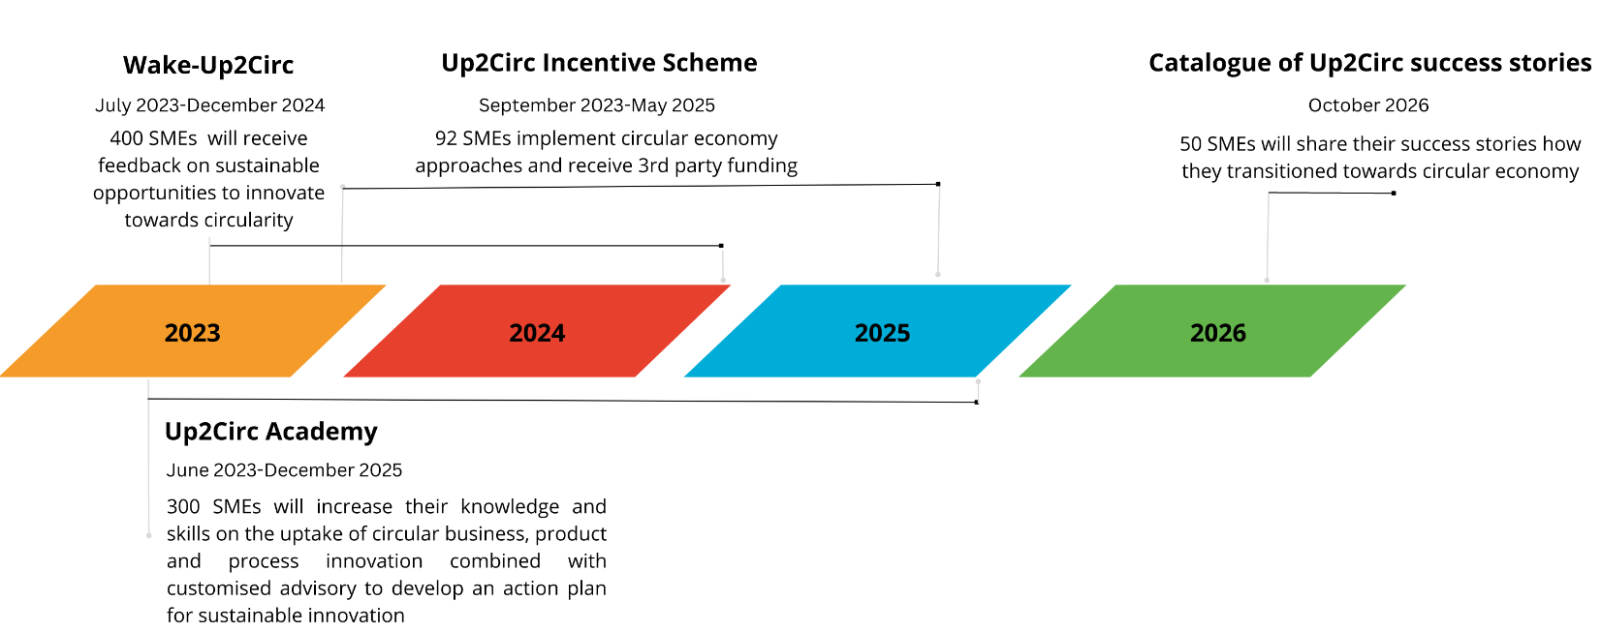
Project timeline
Pilot run starts
June 2023
Call deadline: 11/2023
First open loop starts November 2023:
Call deadline: 5/2024
Second open loop starts May 2024
Call deadline: 5/2025

Slide 23
Let’s make Europe more circular!
https://up2circ.eu

